Slide 1

FOR WOMEN’S INSTITUTE OF TECHNOLOGY & INNOVATION (WITI)
A PROJECT REPORT ON A PROPOSED STUDENT MANAGEMENT SYSTEM (SMS)
PREPARED ON: 11th/12/2024 BY: NABATANZI GORRET & KOBUMANZI ESETHER

Slide 2
Your best quote that reflects your approach… “It’s one small step for man, one giant leap for mankind.”
INTRODUCTION
The Student Management System (SMS) for Women’s Institute In Technology and Innovation Uganda (WITI) is a digital solution designed to streamline the management of student records, attendance, grades, and notifications. The project aims to replace traditional paper-based and file-based methods with a centralized, automated system to improve accuracy, accessibility, and operational efficiency..

Slide 3
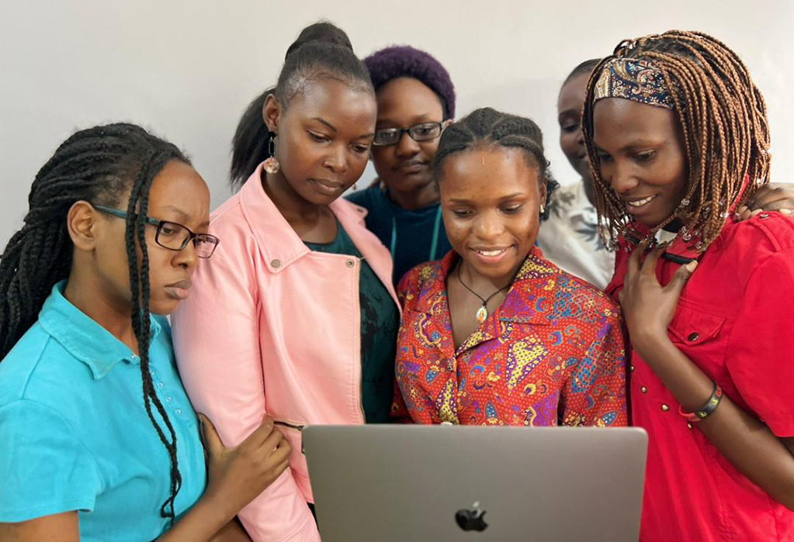

Your best quote that reflects your approach… “It’s one small step for man, one giant leap for mankind.”
Organization background
Women’s Institute of Technology and Innovation (WITI) is a Code Academy founded by Women In Technology Uganda (WITU) with a strong vision to close the technological gender gap in Uganda.
Located in Kamokya, Kanjokya Street, opposite Cavendish University, WITI focuses on empowering young women with the necessary skills to excel in the technology sector. The institute offers a Diploma in Computer Science and Entrepreneurship, catering to female students who have completed the Ugandan Advanced Certificate of Education (UACE) with a science-focused curriculum at their A-level.

Slide 4
Your best quote that reflects your approach… “It’s one small step for man, one giant leap for mankind.”
Problem Statement
Women’s Institute of Technology and Innovation (WITI) currently relies on file-based approaches for managing student records and paper-based methods for attendance tracking. This leads to duplication of records, frequent errors in record-keeping and attendance tracking and delays in accessing vital information. The absence of a centralized system hinders efficient data management and timely decision-making, affecting both students and staff.

Slide 5
Your best quote that reflects your approach… “It’s one small step for man, one giant leap for mankind.”
main Objective of the PROPOSED SYSTEM
To design and implement a comprehensive Student Management System (SMS) WITI that digitizes students records management. which will replace the file-based approaches and paper- based methods with a centralized digital solution improving accuracy, eliminating data redundancy, ease accessibility and operational efficiency.

Slide 6
Your best quote that reflects your approach… “It’s one small step for man, one giant leap for mankind.”
specific Objectives
To gather requirements for the proposed digital system.
Design the process flows for the proposed system.
Develop a digitized Student Management System.
Test, Deploy and Implement the proposed system.

Slide 7
Your best quote that reflects your approach… “It’s one small step for man, one giant leap for mankind.”
Significance of the System
JUSTIFICATION
The proposed system enhances WITI’s operational efficiency by transitioning from the existing manual processes to a modern digital system. The implementation of the Student Management System is expected to improve data accuracy of student records, eliminate data redundancy and streamline administrative tasks.
The Student Management System addresses the inefficiencies that arise from managing student data in the existing file-based system. By digitizing the student management system, we shall have centralized information management which in turn makes general administration easier and more efficient.

Slide 8
Your best quote that reflects your approach… “It’s one small step for man, one giant leap for mankind.”
FEASIBILITY STUDY
The feasibility study explored the practicability of developing and implementing a Student Management System (SMS) for Women’s Institute of Technology and Innovation (WITI).
The purpose of the feasibility study was to evaluate the potential of implementing a Student Management System (SMS) at Women’s Institute of Technology and Innovation (WITI).

Slide 9
Your best quote that reflects your approach… “It’s one small step for man, one giant leap for mankind.”
Objectives of the Study
Identify Challenges: Assess the current challenges faced by the manual student management system, including inefficiencies and inaccuracies in data handling.
Evaluate Feasibility: Determine the feasibility of transitioning to a Student Management System (SMS) that improves accuracy, efficiency, and user experience.
Analyze Costs and Benefits: Evaluate the potential costs and benefits associated with implementing the SMS, including impacts on administrative processes and overall institutional performance.

Slide 10
Your best quote that reflects your approach… “It’s one small step for man, one giant leap for mankind.”
Scope of the Study
This feasibility study encompassed the following areas:
Technical Aspects: Evaluation of the technical requirements for implementing a Student Management System (SMS), including infrastructure, software, and hardware capabilities necessary for efficient operation.
Economic Aspects: Analysis of the financial implications of transitioning to an SMS, including initial costs, potential savings, and return on investment.
Operational Aspects: Examination of how the SMS will integrate into existing workflows, improve administrative processes, and enhance overall institutional efficiency.

Slide 11
Your best quote that reflects your approach… “It’s one small step for man, one giant leap for mankind.”
Current Infrastructure Assessment
WITI possesses a robust technological infrastructure, including:
Hardware: Sufficient computers in student labs and laptops provided to staff, all equipped with necessary software (like, web browsing).
Network: Reliable Wi-Fi access supported by a network server.
Cloud Hosting: A cloud shared hosting server already in use for the institution’s website, with good security protocols, including secure protocols and SSL certificates.
Operating Systems: Both the computers in the computer and the laptops provided to the staff member have up to date Operating Systems (Windows, Ubuntu, MacOS). During system use, the system will be multi-platform independent.
Support for the Proposed SMS: The existing infrastructure is capable of supporting the proposed SMS, as all necessary components are in place. The cloud server can accommodate the SMS, ensuring secure and efficient operations.

Slide 12
Your best quote that reflects your approach… “It’s one small step for man, one giant leap for mankind.”
Technology Requirements
1. Technical Stack
Frontend: Frameworks
Laravel Blade: for templating, alongside Laravel Livewire for dynamic components.
Backend: PHP (Laravel framework) and a MySQL Database
2. Security: Implementing security features such as encryption for sensitive data, multi-factor user authentication, and regular backups to ensure data integrity and security.
3. Hosting: The SMS will be hosted in the cloud, providing cost-effectiveness and scalability.
4. Operating System: The system will run on a server with a compatible OS, such as Ubuntu or CentOS, which are suitable for web applications and provide a stable environment for PHP and MySQL.

Slide 13
Your best quote that reflects your approach… “It’s one small step for man, one giant leap for mankind.”
Technical Feasibility: Conclusion
Conclusion: The proposed Student Management System (SMS) was technically feasible, supported by WITI’s existing infrastructure, including sufficient hardware, reliable Wi-Fi, and a capable cloud hosting server. Recommended upgrades to the cloud package and internet connectivity will enhance performance. Overall, the institution is prepared for a successful SMS implementation.

Slide 14
Your best quote that reflects your approach… “It’s one small step for man, one giant leap for mankind.”
Operational Feasibility
Staff and Student Readiness: WITI’s staff and students are prepared to adapt to the new Student Management System (SMS). Staff members are proficient in similar systems, while many have software development knowledge.
Integration into Current Workflows: The SMS will streamline tasks like registration, attendance tracking, and grading, reducing manual efforts and enhancing workflow efficiency.
Training Requirements
Staff: No training needed as they are already skilled interms of the use of such systems
Students: Basic training sessions may be offered by staff to ensure familiarity with the SMS features.
Conclusion: Overall, the operational feasibility of implementing the SMS at WITI is strong, given the readiness of both staff and students, the positive impact on existing workflows, and the minimal training requirements. This readiness supports the successful adoption and long-term use of the proposed system

Slide 15
Your best quote that reflects your approach… “It’s one small step for man, one giant leap for mankind.”
Economic Feasibility
1. Development Costs
Student Developers
5 Best students working for 3 months.
Total = 5 students × UGX 300,000 × 3 months = UGX 4,500,000.
Professional Developer
1 Proficient developer working for 3 months.
Total = UGX 2,000,000 × 3 months
= UGX 6,000,000.
2. Infrastructure Costs
Cloud Hosting: UGX 200,000 per year.
3. Testing Costs
Since WITI staff can effectively test the functional features and provide feedback, this will reduce additional costs associated with third-party testing. Therefore, UGX 0 for testing.
4. Maintenance Costs:
Estimated at UGX 600,000 annually for the developer’s maintenance support after deployment.

Slide 16
Your best quote that reflects your approach… “It’s one small step for man, one giant leap for mankind.”
Cost-Benefit Analysis
Expected Benefits
By leveraging the expertise of WITI's best students and a proficient developer, the institution minimizes development costs while providing valuable learning opportunities for students.
The collaboration will enhance students' skills and practical experience while ensuring that the system aligns with WITI's needs.
The anticipated benefits of increased operational efficiency, improved data management, and support for WITI’s mission to bridge the technological gender gap will outweigh the development and maintenance costs.
Conclusion: The economic feasibility of the SMS at WITI indicates a viable project with costs totaling
UGX 11,300,000. Utilizing existing resources and student developers minimizes expenses while enhancing efficiency and data accuracy. The anticipated benefits outweigh the costs, confirming the project's feasibility.

Slide 17
Your best quote that reflects your approach… “It’s one small step for man, one giant leap for mankind.”
Conclusion
The feasibility study for the proposed Student Management System (SMS) at the Women’s Institute of Technology and Innovation (WITI) supports its implementation across all dimensions.
Technical Feasibility: WITI has the necessary hardware, software, and network infrastructure, including cloud hosting, to support the SMS, which will utilize PHP (Laravel) and MySQL.
Operational Feasibility: Staff and students are ready to adapt to the new system, with proficient staff available to train students. Student developers will collaborate on the project, ensuring smooth integration into existing workflows.
Economic Feasibility: The estimated cost for development and maintenance is UGX 11,300,000. Utilizing existing resources and student involvement minimizes costs while enhancing efficiency and data accuracy.
In summary, the SMS project is feasible and aligns with WITI’s mission to provide quality education and bridge the technological gender gap in Uganda.

Slide 18
Your best quote that reflects your approach… “It’s one small step for man, one giant leap for mankind.”
REQUIREMENTS GATHERING
Objective of Requirement Gathering: The objective of requirement gathering for the Student Management System (SMS) was to fully understand user needs, define essential functionalities, and establish standards for security, usability, and performance. This process also identifies any technical or organizational constraints and sets business rules to ensure data integrity and proper access, creating a system that supports the institution’s academic and administrative needs effectively
Methodology for Requirement Gathering: The primary requirements gathering instrument was interviews with guided questions. This format enabled us to capture in-depth responses, allowing participants to elaborate on their experiences and expectations for the SMS.

Slide 19
Your best quote that reflects your approach… “It’s one small step for man, one giant leap for mankind.”
REQUIREMENTS GATHERING
The interview questions covered the following areas;
1. Desired functionalities in the SMS.
2.Challenges with the current file-based system.
3.Expected roles and tasks for different user types.
4.Types of student information the SMS should manage.
5.Specific reporting and data insights required.

Slide 20
Your best quote that reflects your approach… “It’s one small step for man, one giant leap for mankind.”
Functional Requirements
Based on interview responses, the following functional requirements have been identified for the SMS:
Student Information Management
Store and manage essential student details, such as ID, contact information, and academic records.Enable easy access to attendance records, grades, and feedback from lecturers.
.Enrollment and Registration
Allow students to register for courses digitally.
1.User Management
Define roles (Student, Lecturer, Admin) with specific access permissions.
Manage user profiles, including secure login credentials and role-based access.

Slide 21
Your best quote that reflects your approach… “It’s one small step for man, one giant leap for mankind.”
Functional Requirements
Based on interview responses, the following functional requirements have been identified for the SMS:
Student Information Management
●Store and manage essential student details, such as ID, contact information, and academic records.Enable easy access to attendance records, grades, and feedback from lecturers.
.Enrollment and Registration
●Allow students to register for courses digitally.
●3●Enable administrative oversight of course enrollment status.
4.Course Management
●Manage course information, including objectives, outcomes, and content.
●Allow lecturers to update course-related materials and assessments.
5.Attendance Tracking
●Provide QR code scanning for quick attendance logging.
●Track attendance and generate reports on student engagement.
6.Student Application
●Streamline the application process with an online submission, review, and tracking mechanism.
●Allow administrative staff to review applications, manage enrollment statuses, and notify applicants.
7.Academic Calendar
●Maintain a centralized calendar with key dates, such as assignment deadlines and exam schedules.
●Allow updates by administrative staff for real-time access.
8.Payment Processing
●Track tuition and fee payments, with receipt generation and reporting.
●Enable administrators to monitor payment records for financial management.
9.Grading and Assessment
●Allow lecturers to input grades and provide feedback.
●Enable students to view grades and comments in real time.
10.Reports and Analytics
●Generate customized reports on attendance, grades, and course progress.
●Provide analytics to aid in academic and administrative decision-making.

Slide 22
Your best quote that reflects your approach… “It’s one small step for man, one giant leap for mankind.”
PREPARED BY NABATANZI GORRET
and
KOBUMANZI ESETHER Date: October 14, 2024

